Slide 1


Team Details
Team name:
Team leader name:
Problem Statement: Digital Asset Protection

Slide 2
Brief:
DMCA Forge is a Next.js 16 application built to safeguard high-value digital sports media. It addresses the challenge of widespread content misappropriation by automating the creation of DMCA takedown notices. Users input infringing asset details, and the system leverages Gemini AI to instantly generate a formal, legally structured notice. This solution empowers rights holders to proactively protect intellectual property and manage digital asset integrity efficiently.

Slide 3
Opportunities:
• Differentiation
• DMCA Forge stands out with its AI-powered, instant legal drafting capabilities, specifically tailored for the digital sports media domain. Its unique Flat Design UI prioritizes clarity and efficiency over conventional, often complex, legal interfaces. This combination offers a distinct, user-friendly, and highly effective tool for IP protection.
• Problem Solving Approach
• The tool directly tackles the labor-intensive and error-prone nature of drafting DMCA notices. By abstracting complex legal requirements into a simple input form and leveraging AI for formal language, it drastically reduces the time and effort needed to respond to infringements. This proactive approach helps organizations maintain control over their valuable digital assets.
• USP
• Instant, AI-generated, and legally compliant DMCA takedown notices—empowering sports organizations with a rapid, professional, and actionable solution for comprehensive digital asset protection.

Slide 4
Features:
• Intuitive Input Form: Collects essential details like rights holder name, asset description, original/infringing URLs, and date of infringement.
• AI-Powered DMCA Drafting: Utilizes Google Gemini (`gemini-2.5-flash`) to generate formal, legally structured DMCA Section 512(c) takedown notices.
• Formatted Output Display: Presents the generated legal notice with clear visual hierarchy, ready for immediate use.
• Loading & Error Handling: Provides clear visual feedback during API requests and gracefully manages potential errors.
• Responsive Flat Design UI: Delivers a professional, visually distinct user experience across all devices with a deep navy and electric gold color palette.

Slide 5
Technologies:
• Frontend Framework: Next.js 16 (App Router)
• Language: TypeScript
• Styling: Tailwind CSS + Custom CSS Variables
• Icons: lucide-react
• AI Integration: Google Gemini API (`gemini-2.5-flash`)
• Runtime Environment: Node.js 24.x

Slide 6
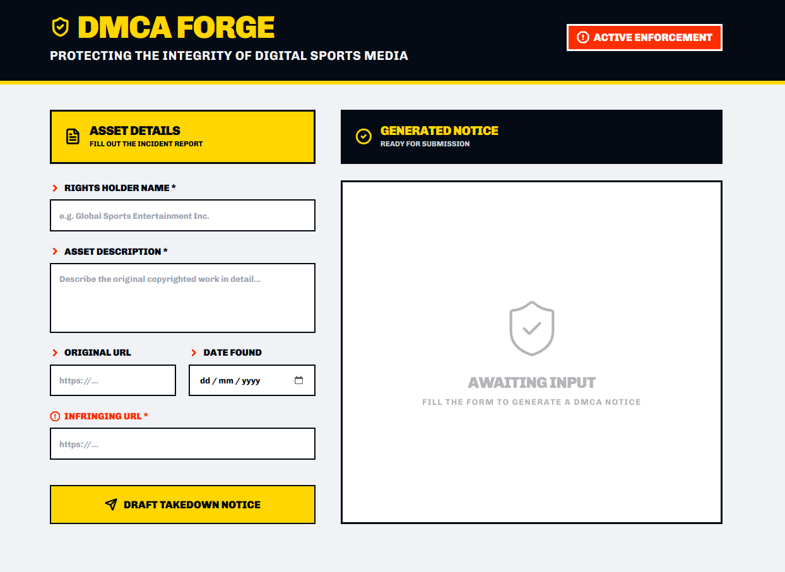
Snapshots of the MVP

Slide 7
Links:
GitHub Public Repository
Working Prototype Link: https://dmcaforge.vercel.app/

Slide 8


